Slide 1
Multiplexer
A multiplexer is a device which has
(i) number of input lines
(ii) number of selection lines
(iii) only one output line
It steers one of 2^{n} inputs to a single output line, using n selection lines. Also known as a data selector.
2^{n}:1
Multiplexer
inputs
output
...
select

Slide 2
Multiplexer
Truth table for a 4-to-1 multiplexer:
Inputs
Inputs
I₀
0
1
2
3
I₀
I₁
4:1
MUX
I₁
I₂
Y
Output
I₂
mux
Y
I₃
I₃
S₁ S₀
S₁ S₀
select
select

Slide 3
Multiplexer
Output of multiplexer is
“sum of the (product of data lines and selection lines)”
Example: the output of a 4-to-1 multiplexer is:
Y = I₀.(S₁’.S₀') + I₁.(S₁’.S₀) + I₂.(S₁.S₀') + I₃.(S₁.S₀)
A 2^{n}-to-1-line multiplexer, or simply 2^{n}:1 MUX, is made from an n: 2^{n} decoder by adding to it 2^{n} input lines, one to each AND gate.

Slide 4
Multiplexer
I₀
I₁
Y
I₂
I₃
S₁
S₀

Slide 5
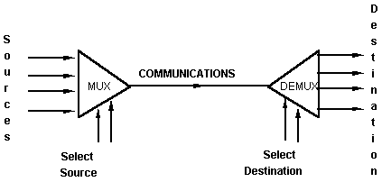
Multiplexer
An application:
Helps share a single communication line among a number of devices.
At any time, only one source and one destination can use the communication line.

Slide 6
Larger Multiplexers
Larger multiplexers can be constructed from smaller ones.
An 8-to-1 multiplexer can be constructed from smaller multiplexers like this (note placement of selector lines):
I₀
I₁
I₂
I₃
4:1 MUX
2:1 MUX
S₁ S₀
Y
I₄
I₅
I₆
I₇
4:1 MUX
S₂
S₁ S₀

Slide 7
Larger Multiplexers
I₀
I₁
I₂
I₃
When
S₂S₁S₀ = 000
I₀
4:1 MUX
2:1 MUX
I₀
S₁ S₀
Y
I₄
I₅
I₆
I₇
4:1 MUX
I₄
S₂
S₁ S₀

Slide 8
Larger Multiplexers
When
S₂S₁S₀ = 110
I₀
I₁
I₂
I₃
I₂
4:1 MUX
2:1 MUX
I₆
S₁ S₀
Y
I₄
I₅
I₆
I₇
4:1 MUX
I₆
S₂
S₁ S₀

Slide 9
Larger Multiplexers
Another implementation of an 8-to-1 multiplexer using smaller multiplexers:
When
S₂S₁S₀ = 000
I₀
I₁
2:1 MUX
I₀
I₂
I₃
2:1 MUX
I₂
S₀
4:1 MUX
I₀
S₀
I₄
I₅
2:1 MUX
I₄
S₂ S₁
S₀
I₆
I₇
2:1 MUX
I₆
S₀

Slide 10
Larger Multiplexers
When
S₂S₁S₀ = 001
I₀
I₁
I₂
I₃
4:1 MUX
2:1 MUX
S₁ S₀
Y
I₄
I₅
I₆
I₇
4:1 MUX
S₂
S₁ S₀

Slide 11
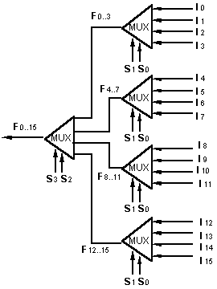
Larger Multiplexers
A 16-to-1 multiplexer can be constructed from five 4-to-1 multiplexers:

Slide 12
Multiplexers: Implementing Functions
F(A,B,C) = Σ m(1,3,5,6)
0
1
0
1
0
1
1
0
0
1
2
3
4
5
6
7
This method works because:
Output = m₀.I₀ + m₁.I₁ + m₂.I₂ + m₃.I₃ + m₄.I₄ + m₅.I₅ + m₆.I₆ + m₇.I₇
Supplying ‘1’ to I₁,I₃,I₅,I₆ , and ‘0’ to the rest:
Output = m₁ + m₃ + m₅ + m₆
F
mux
A B C

Slide 13
Multiplexers: Implementing Functions
A Boolean function can be implemented using multiplexers.
A 2^{n}-to-1 multiplexer can implement a Boolean function of n input variables, as follows:
(i) Express in sum-of-minterms form.
Example: F(A,B,C) = A'B'C + A'BC + AB'C + ABC'
= Σ m(1,3,5,6)
(ii) Connect n variables to the n selection lines.
(iii) Put a '1' on a data line if it is a minterm of the function, '0' otherwise.

Slide 14
Multiplexers: Implementing Functions
F(A,B,C) = Σ m(1,3,5,6)
0
1
0
1
0
1
1
0
0
1
2
3
4
5
6
7
This method works because:
Output = m₀.I₀ + m₁.I₁ + m₂.I₂ + m₃.I₃ + m₄.I₄ + m₅.I₅ + m₆.I₆ + m₇.I₇
Supplying ‘1’ to I₁,I₃,I₅,I₆ , and ‘0’ to the rest:
Output = m₁ + m₃ + m₅ + m₆
F
mux
A B C

Slide 15
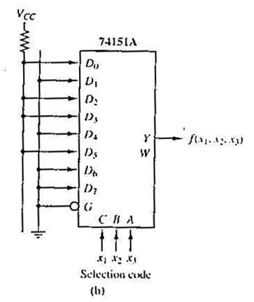
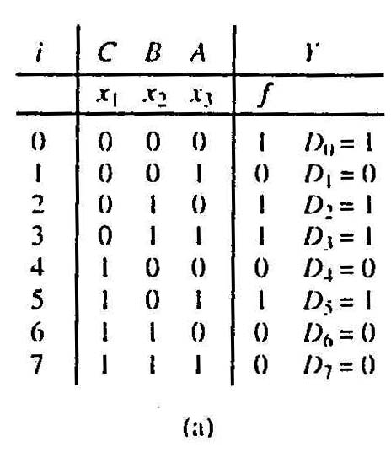
Multiplexers: Implementing Functions
Example: Use a 74151A to implement:
f(x₁,x₂,x₃) = ∑ m(0,2,3,5)
Realization of f(x₁,x₂,x₃) = ∑m(0,2,3,5).
(a)Truth table.
(b)Implementation with 74151A.

Slide 16
Using Smaller Multiplexers
Earlier, we saw how a 2^{n}-to-1 multiplexer can be used to implement any Boolean function of n (input) variables.
However, we can use a single smaller 2^{(n-1)}-to-1 multiplexer to implement any Boolean function of n (input) variables.
In particular, the earlier function
F(A,B,C) = ∑ m(1,3,5,6)
can be implemented using a 4-to-1 multiplexer (rather than an 8-to-1 multiplexer).

Slide 17
Using Smaller Multiplexers
Let’s look at this example:
F(A,B,C) = Σ m(0,1,3,6) = A’B’C’ + A’B’C + A’BC + ABC’
A’B’
1
1
0
1
0
0
1
0
0
1
2
3
4
5
6
7
1
C
0
C'
0
1
2
3
F
mux
F
mux
A B C
A B
Note: Two of the variables, A, B, are applied as selection lines of the multiplexer, while the inputs of the multiplexer contain 1, C, 0 and C'.

Slide 18
Using Smaller Multiplexers
Procedure
1) Express boolean function in “sum-of-minterms” form.
e.g. F(A,B,C)= Σ m(0,1,3,6)
2) Reserve one variable (in our example, we take the least significant one) for input lines of multiplexer, and use the rest for selection lines.
e.g. C is for input lines, A and B for selection lines.

Slide 19
Using Smaller Multiplexers
3) Draw the truth table for function, but grouping inputs by selection line values, and then determine multiplexer inputs by comparing input line (C) and function (F) for corresponding selection line values.
1
0
0
1
2
3
C
F
mux
A B

Slide 20
Using Smaller Multiplexers
Alternative: What if we use A for input lines, and B, C for selector lines?
A’ (when BC = 00)
A’ (when BC = 01)
A (when BC = 10)
A
0
1
2
3
F
A’ (when BC = 11)
mux
B C

Slide 21
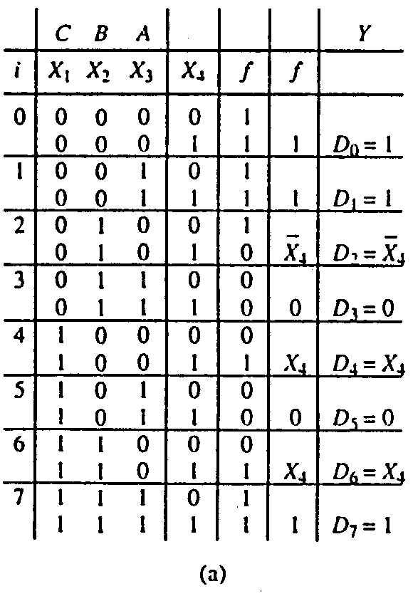
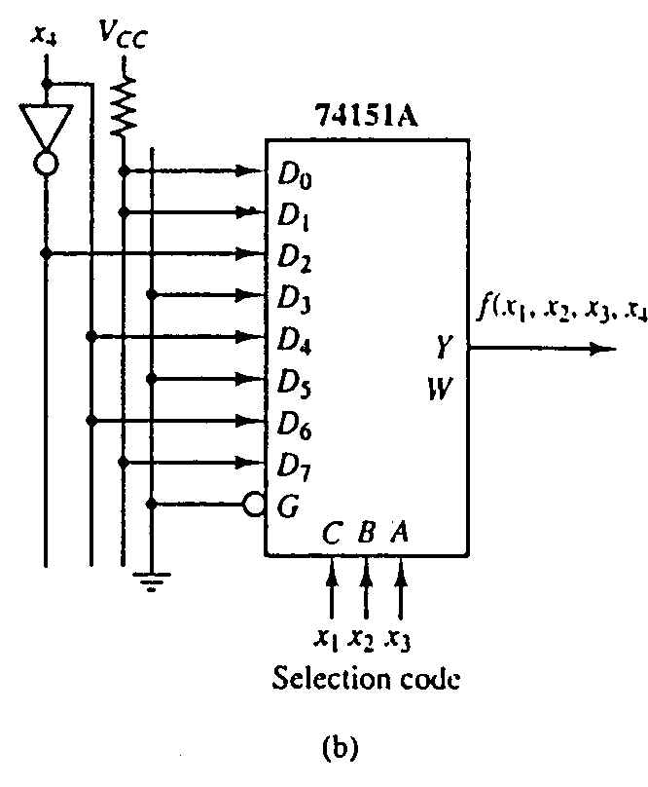
Using Smaller Multiplexers
Example: Implement using a 74151A the function:
f(x₁,x₂,x₃,x₄) = ∑ m(0,1,2,3,4,9,13,14,15)

Slide 22
Implement the Boolean function by using 8x1 MUX –
F(A,B,C,D)=∑m(0,1,3,4,8,9,14,15)
Total number of variables , n= 4 (A,B,C,D)
Select line variable (n-1) = 3 (B,C,D) Input variable = 1 (A)
Implementation table –
 | I0 | I1 | I2 | I3 | I4 | I5 | I6 | I7
(A’)0 | 0 | 1 | 2 | 3 | 4 | 5 | 6 | 7
(A)1 | 8 | 9 | 10 | 11 | 12 | 13 | 14 | 15
 | 1 | 1 | 0 | A’ | A’ | 0 | A | A

Slide 23
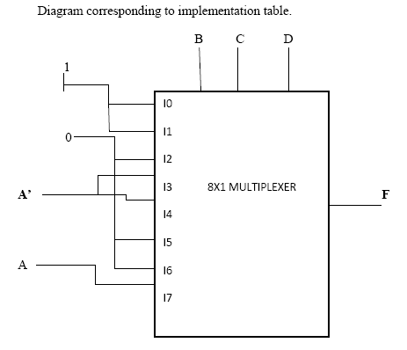

Slide 24

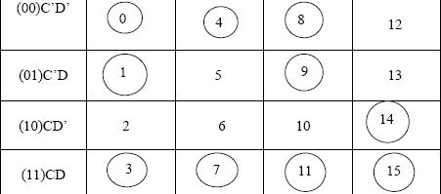
Implement the following function using 4x1 MUX- F(A,B,C,D)=∑m(0,1,3,4,7,8,9,11,14,15)

Slide 25
Solving minterms corresponding to I0-
I0→ C’D’+C’D+CD
=C’(D’+D)+CD
=C’+CD
=C’+D
Solving minterms corresponding to I1-
I1→ C’D’+CD = C (X-NOR) D
Solving minterms corresponding to I2-
I2→ C’D’+C’D+C = C’+D
Solving minterms corresponding to I3-
I3→ CD’+CD = C

Slide 26
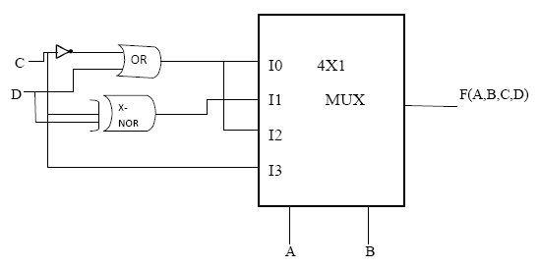

Slide 27
w
0
w
1
s
w
y
0
0
0
s
w
y
f
1
1
1
y
w
2
2
1
En
y
3
w
3
Figure 6.19. A 4-to-1 multiplexer built using a decoder.

